Slide 1
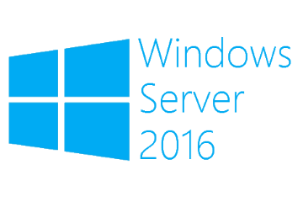
Hyper-V VM version
Megaseries

Slide 2
Introduction
VMs on Windows Server 2016 have a new configuration file type with the extension VMCX
On Windows Server 2012 R2 and earlier, the configuration file was XML
VMs now expose their configuration version in the GUI and through Powershell
Older version VMs can run on newer hosts but do not benefit from enhanced features
To upgrade a VM version, it must be shut down first

Slide 3
New config file and version
VMs on Windows Server 2012 R2 have version 5 and use XML as the configuration file
VMs on Windows Server 2016 have version 8 and use VMCX as the configuration file and VMRS as the runtime state data file
The new configuration file is now binary instead of text
The new format increases efficiency in reading and writing and protects better against corruption

Slide 4

https://www.youtube.com/channel/UCcZ-jLbPwNr8E_v9-65n8Iw https://github.com/itknowledge4

